Slide 1

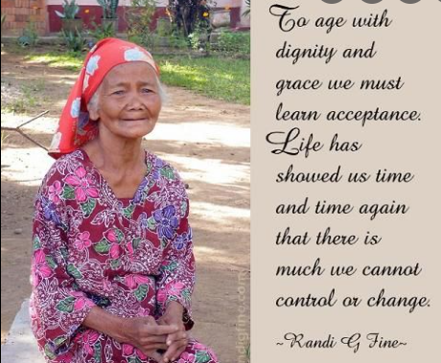

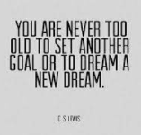
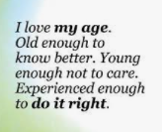
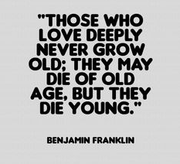
Ageing with Dignity & Meaning
SenzeHealth Elder Care Training
Version 3 for Volunteers, with a road map towards paid professional care giving
Prototype 2021.7.30
Duration: 2-4 hours

Slide 2

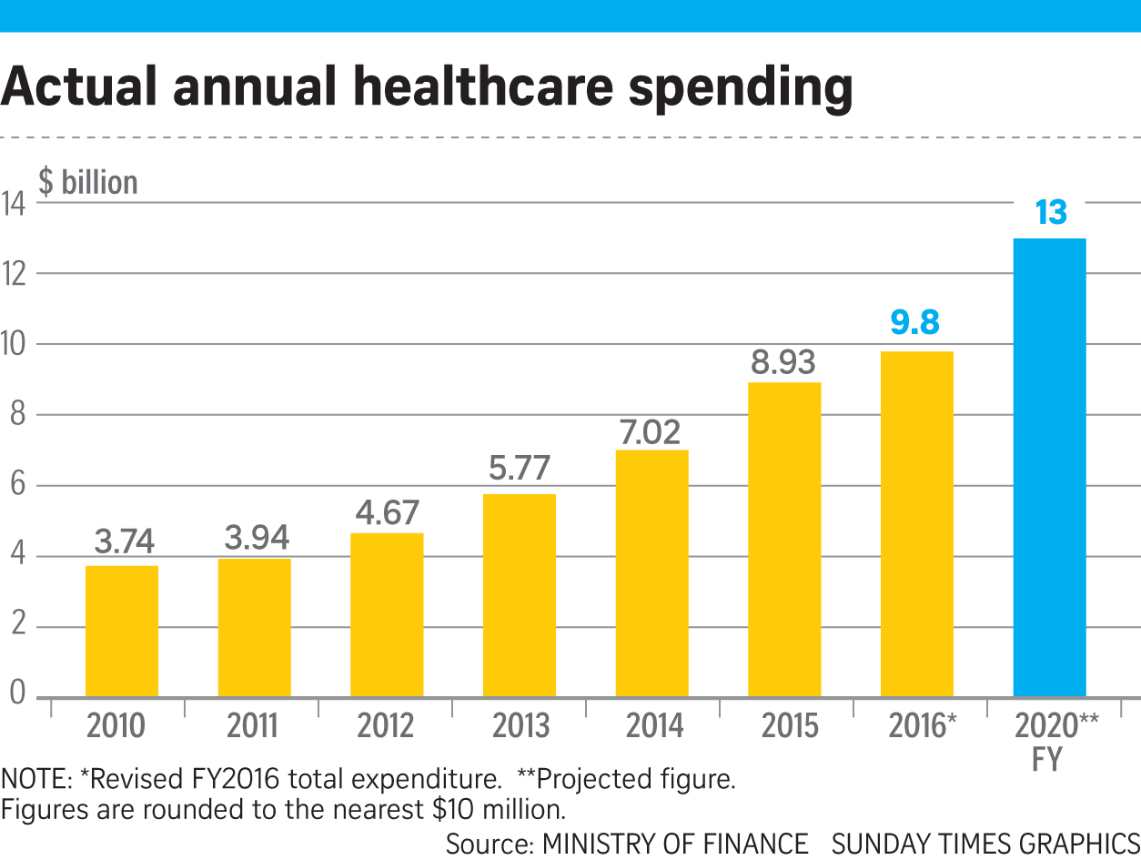
Rapidly Aging Population in Singapore and Other Countries
Seniors age 60+
Aging in-place / Nursing home
Healthcare facility / Hospital
47% segment by year 2050
#3

Slide 3
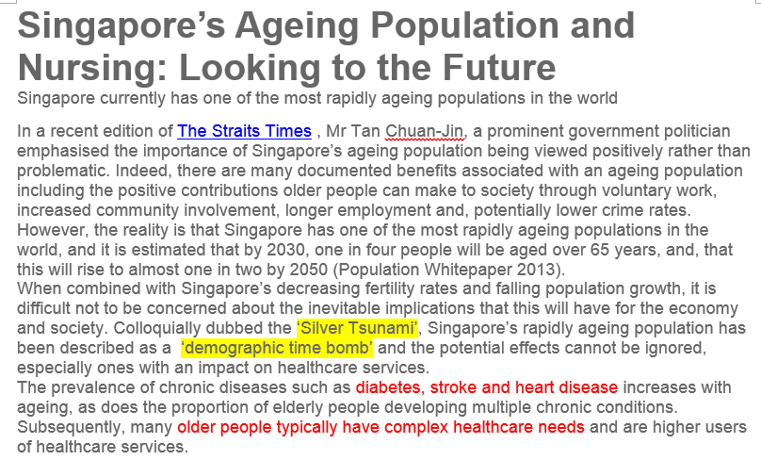
Ageing Population: Landscape Overview
https://www.straitstimes.com/singapore/ageing-should-be-talked-about-positively-and-not-as-a-problem-tan-chuan-jin
https://www.simge.edu.sg/news/singapores-ageing-population-and-nursing-looking-to-the-future/

Slide 4
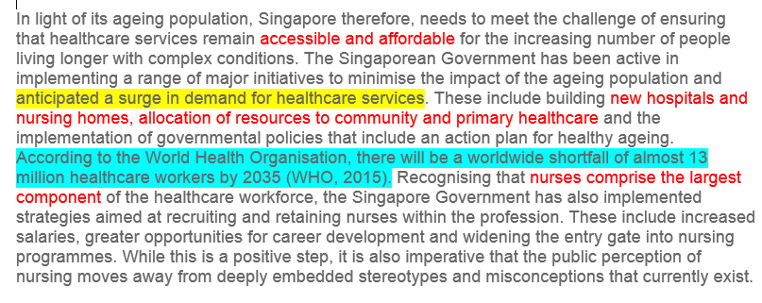
Ageing Population: Landscape Overview
https://www.straitstimes.com/singapore/ageing-should-be-talked-about-positively-and-not-as-a-problem-tan-chuan-jin
https://www.simge.edu.sg/news/singapores-ageing-population-and-nursing-looking-to-the-future/

Slide 5
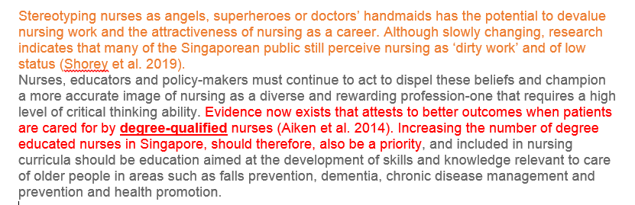
Ageing Population: Landscape Overview
Need for change in mind set
Supports the idea of having formally trained “non-nurse care professionals”
https://www.simge.edu.sg/news/singapores-ageing-population-and-nursing-looking-to-the-future/

Slide 6
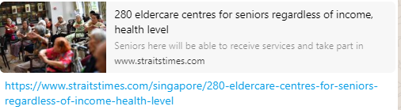
Ageing Population: Landscape Overview

Slide 7
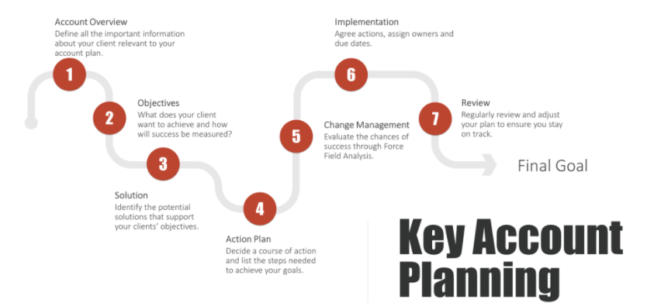
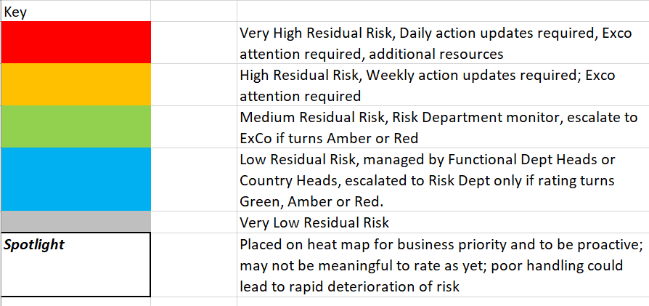
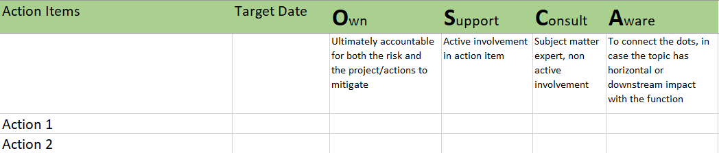
Care Giving Framework and Ecosystem
Horizon scan
Care Giver Workshops
Conversations with Clients
Process walkthrough; audits
Thematic reviews
VENDORS + PARTNERS
I
Care Giver Register
Risk Management Matrix
dentification
Care Clients and Care Giver matching algorithm
Knowledge Database
A
Likelihood
Impact
ssessment
Care Giver profile
(continuous loop)
HR + Finance work flows
Vendor: COUPA, Xero/Quicbook systems
R
Heat Map Actions
OSCA
Internal, external, consultants
esponse
Care Client Profile
Monthly Management Meetings
Action Item Tracker
Training,
Culture Workshop,
Int / Ext Comms
T
racking
Care Giver
Onboarding
Learning Management System
Collaboration tools : G-suite, Slack, Confluence, Wrike

Slide 8
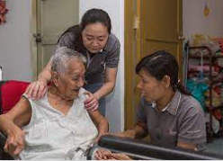
Three possible Elder Care Pathways
Adoption
2020
Nursing
Non-nursing
Domestic Helper
SenzeHub Elder Care Training
Homage
Jaga-Me
Volunteer
Paid Professional
Permanent full time
Permanent part time
On call, or “advanced booking”
basis
Initial pool from those who had been elder care givers either on personal basis (gave up jobs) OR have an innate natural interest. Some reference checks may be necessary to validate interest and best fit, especially for Home Visits
Trained to apply
the principles around
levels of care.
May recommend calling
n professional nurses
If the need arises
Facilitates the
ecosystem
Initial attachments:
Welfare Agency
Aged Home
Elder Care centres
Home visits (refer to subsequent slides)

Slide 9
3 Broad Types of Care
Less effort
Adoption
2020
Supervisory
Monitor a Care Client
Be alert to functioning and continuing needs
Ability to intervene in an emergency
Assist with self administration of medication
Personal
Assist with activities of daily living
Co-ordinate with outside and ancillary services
Oversee medication and treatment provided by doctors and nurses
Directed
Assist Care Clients who are incapable of recognizing danger, summoning assistance, expressing need, or making basic care decisions (eg Alzheimer’s)
More effort

Slide 10


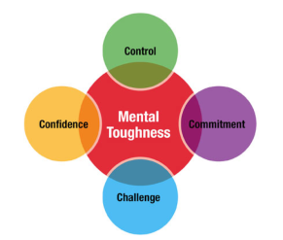

Elder Care Givers – Range of Profiles
Have a heart to genuinely care for the elderly
Has had some experience caring for the elderly (eg
had to give up job or work part time
to care for someone in the immediate
family)
Demonstrates the right psychological and mental
strength to handle a range of potential care
scenarios
Open minded to find new paths eg embracing the adventure
of progressing from a volunteer to becoming a paid
care professional

Slide 11
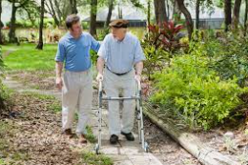

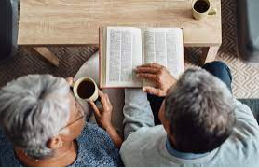
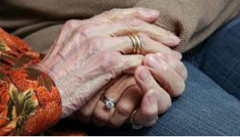
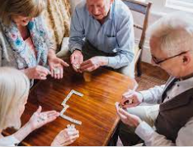
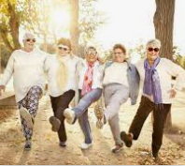

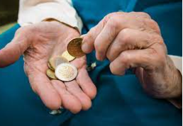
Needs of Elders – a holistic view of the total person
Physical
Emotional
Meaningful Purpose for Living
/ Spiritual
Mental
Social / Community
Financial

Slide 12

Ethical Principles
Bernard
Represent the facts truthfully and authentically
Ask whether your decisions reflect the rights of others
Ask whether your decisions are just
Contemplate the benefits and consequences of an action. Weigh all options.
Contemplate if an action results in greater good
Keep communication channels open
When in doubt, consult, consult, consult

Slide 13
Rights of Care Clients
Bernard
Environment
To live in an environment that is conducive for independence, privacy and personal choice.
Treatment
To be treated with consideration, respect and dignity.
Privacy
To have privacy in correspondence, communications, visitations, hygiene and health related services

Slide 14
Rights of Care Clients
Bernard
Choice
To refuse services unless court ordered, or other individuals are endangered by the refusal of services
Personal Possessions
To maintain and use personal possessions unless such use poses dangers to others or to the Care Giver.
To request for a change in Care Giver

Slide 15
Rights of Care Clients
Bernard
Confidentiality
To have financial and other records kept in confidence without divulgence to unauthorized parties
Grievances
To submit grievances to SenzeHealth Head Office, or other government agencies without retaliation or constrant.

Slide 16
Communicating with Care Clients
Bernard
Allow Care Client to reminisce and grieve
Sense of loss may often been experienced by elders. Could lead to depressions, social withdrawal, irritability.
Death of friends and loved ones, inability to work and be independent, changes in health and finances
Be respectful
Of the elder’s background, knowledge, values
Instead of waving person off, pay attention to what the elder is saying
Listen
Listen carefully. Speak slowly.
Repeat the message to ensure proper understanding both ways.
Demonstrate that you value their opinion
Ask elder to write if the elder is unable to speak clearly.
Remember the elder may be agitated at not being to get message across.

Slide 17
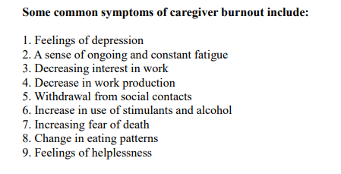
Preventing Care Giver burn out
Bernard

Slide 18
Preventing Care Giver burn out
Bernard
Accept help from others if necessary. Seek advice proactively.
Avoid unrealistic expectations
CELEBRATE STORIES
Give yourself brownie points for contributing to the life of your Care Client
Be part of a Care Giver community. You are not alone.
PREVENT BURN OUT
Find ways to recharge your batteries on a regular basis.
Watch your self care. Get enough rest. Eat well. Exercise.
HUMOUR
POSITIVE OUTLOOK

Slide 19


The best way to be an effective Care Giver is to take care of you
Care Givers
Association
Specially curated activities & events for Care Givers to chill, relax, recharge, find emotional support

Slide 20
Nutrition, Hydration, Exercise
Arul
1. Use variety in serving food. Everyone gets tired of the same food day after day or week after week.
2. Doo not overload the plate. This is wasteful and unnecessary.
3 Serve food with different texture and colours for an interesting menu. Depending on the time of day or preference, you can also serve hot or cold meals.
4. As we age, we can also lose awareness of being thirsty. Without adequate fluids, these problems can arise:
Dry Skin
Indigestion
Constipation
Urinary Tract Infections (UTIs)
Lethargy
Bad breath
Dizziness
Confusion
5. To prevent such ailments, ensure that each resident drinks at least eight 8-oz glasses of water. It will also help to give appetising drinks such as coloured fruit juices instead of water.
6. Some conditions such as congestive heart failure require restricted intake of water for a resident.
Note the specific amount of water for each resident in the care plan.
7. If you have to coax the person to drink, please do this in an ethical and respectful manner.

Slide 21
Nutrition, Hydration, Exercise
Arul
EXERCISE
Exercise is essential to ensure that each resident stays healthy and avoids conditions such as heart failure, constipation, diabetes and other health problems.
2. Exercise also prevents arthritis, premature muscular contraction, and help non-ambulatory residents regain their movement.
3 Where possible, plan scheduled daily exercise times for residents, or hire a professional to do the exercises instead. Consider playing familiar music that will help the residents to get motivated.
FOOD PREPARATION AND SERVICE
Provide at least three meals a day, with an adequate time period between each meal.
2. Menus should be based on food preferences, eating habits, customs, health conditions, appetites, and religious, cultural, and ethnic backgrounds.
3. Menus should be prepared at least one week before the date the food is served, dated and conspicuously posted.
4. Food and water should be easily accessible at all times.
5. Make sure that the food is stored in proper covered containers and refrigerated in the correct sections. 6. Food must also be safe for consumption, and free of spoilage, filth, or contamination
7. Raw fruits and raw vegetables must be rinsed with water before being cooked or served.
Individuals serving food and water must wash their hands and exposed portions of their arms with soap and water before providing the food service.
Food must not be served by anyone who is ill.
10. Tableware, utensils, equipment, and food-contact surfaces must be clean and in good condition.
If you are in doubt about the food or drinks, discard them!

Slide 22
Medication
Arul
All medication can have mild side effects, or even be dangerous to some people.
Some medications can even cause life-threatening side effects when administered together.
So TREAT ALL MEDICATIONS WITH RESPECT.
Make sure that you are properly trained to administer medication, especially those with life-threatening side effects. If not, make sure that someone with the right qualifications and training is available for that role.
2. Assistance in self-administration generally includes help with one or more of the following:
Correct storage of the medication
Reminding the person of the time to take a medication
Reading the medication label
Confirming that the medication is being taken by the individual it is prescribed for.
Making sure that the correct dosage is delivered.
Confirming that the medication is taken as required and directed
Pouring or placing a specified dosage into a container or into the person’s hand.
Observing the person while the medication is taken.

Slide 23
Medication
Arul
A person’s medication and treatment orders come in several forms.
The initial orders typically come from the hospital, pharmacy, or personal physician and client’s doctor, and usually include:
1. Diagnoses of all the individual’s medical problems
2. All medications or treatments the resident is currently taking, as well as instructions for administration
3. The person’s medication or food allergies, if any
5. A list of non-prescription over-the-counter medications for common problems such
as cough, fever, indigestion, constipation, and headache.
When you receive these details, do the following:
File them properly for later reference
Refer to them when you are unsure about the person’s medication and/or administration instructions
Ensure that the documents are available for reference should there be any investigations or mishaps
Do not make changes to any medication or treatment orders without prior consultation with the person’s pharmacy, doctor or primary healthcare provider!

Slide 24
Home Visits – Safety & Security
George to comment : Can SenzeHealth facilitate SMS platform ??
Care Clients / Family of Care Clients
Care Givers
At least 1 day before the Care Giver makes a Home Visit, Care Clients & designated family members will receive a text message through SenzeHealth, informing of the Care Giver’s name, time of visit and purpose of visit.
Beware of strangers and scammers. Ask to see the official badge of the Care Giver before letting the Care Giver in. Ensure the name matches with the prior day’s text message.
Only “Special Access Care Givers” will be given keys/access cards to a Care Client’s home. These will be pre-authorized by the appropriate family members.
Be aware of fire and water safety in the home – Did the Care Client leave anything on the stove with the fire still going ? Are there wet water patches on the floor which could present fall risk ?
For the safety of female Care Givers visiting the homes of male Care Clients, launch your “one-touch safety app”, which can be voice activated to inform a central control centre that you may be in danger.
For “Special Access Care Givers”, ensure that doors are properly locked before leaving the Care Client’s premises. Send a text message or call the Care Client’s designated family member to inform that you are leaving the premises.

Slide 25
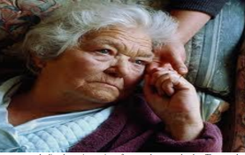
The Ageing Process
Arul
As we age our bodies undergo mainly physical, cognitive and functional changes.
If residents understand the ageing process, they can be able to prevent or cope better with
age-related body changes or conditions such as diabetes, dementia, and eye disease.
Some of these changes are obvious, but others may be unnoticed for long periods of time, and so need careful observation and professional consultation. .
Some common age-related changes are:
Physical Changes
Hearing loss
Dryer skin that tears easily
Vision impairment
Slow or slurred speech
Arthritis and osteoporosis (bone loss)
Loss of mobility or movement
Loss of bowel and bladder control
Loss of teeth
Loss of lung capacity
Cognitive Changes:
Memory loss
Emotional Problems
Loss of reasoning and decision-making ability
Hypochondria
Confusion
Inability to make good judgment
Mood and personality changes

Slide 26
The Ageing Process
Arul
Functional Changes:
These changes are more related to residents unable to direct self-care:
Being unable to cook
Being unable to swallow
Being unable to clean oneself
Being unable to walk (using a walker or wheelchair)
Being unable to bathe
Being unable to take one’s medication
Being unable to drive
Being unable to dress and self-groom
It is important to know what to do when dealing with people who are coping with these changes.
Seek help from a more experienced person or supervisor if you are unsure about how to assist someone with a particular change.

Slide 27
Activities of Daily Living
Arul
As we age, it is essential for adults to be active in order to maintain their health.
Certain daily tasks, known as Activities for Daily Living (ADLs) , indicate how well ageing adults can cope with daily life.
Such ADLS include the following, but this list may not be comprehensive:
Bathing or showering
Eating
Walking
Shaving
Cleaning teeth
Dressing
Assisting with medications
Besides helping people with daily activities, pay close attention to how they cope with ADLs.
Record and/or document any changes in their ADLs and inform the caregivers or medical professionals.
Some ways you can assist someone with their ADLs include the following:
Indicate each person’s ADLs, as well as any changes in them, in an ADL Checklist.
Proper documentation protects you in the unfortunate event of a claim by an individual’s family members (or agency) alleging that the individual was not properly cared for.

Slide 28
Taking vital signs
Arul
Vital signs measure basic body functions and are useful in detecting or monitoring medical problems. Four main vital signs routinely monitored by doctors and healthcare professionals include the following:
1. Body Temperature
2. Pulse Rate
3. Respiration Rate
4. Blood Pressure
Body temperature
As people get older, it is harder for the body to control its temperature. Loss of subcutaneous fat makes it harder to maintain body heat. Ageing also decreases one’s ability to sweat, so older adults find it more difficult to tell when they are overheated. Older people are at greater risk for overheating or heat stroke, as well as dangerous drops in body temperature (hypothermia).
Individual normal body temperature is usually between 36.5° C to 37.2° C.
According to the American Medical Association, a fever is indicated when body temperature rises above 36.9° C orally, or 37.2° C rectally.
Hypothermia is defined as a drop in body temperature below 34.0° C.
Pulse rate
This measures the number of times the heart beats per minute. Taking a pulse can also indicate heart rhythm
The normal pulse for healthy adults ranges from 60 beats to 100 beats per minute. This may change with exercise, illness, injury, and emotions.
Females aged 12 and older generally have faster heart rates than males. Athletes, who have undergone body conditioning, may have heart rates near 40 beats per minute and experience no problems.

Slide 29
Taking vital signs
Arul
HOW TO CHECK YOUR PULSE:
The pulse can be found on the side of the lower neck, on the inside of the elbow, or at the wrist.
When taking your pulse:
1. Use your first and second fingertips to press firmly but gently on the arteries until you feel a pulse.
2. Begin counting the pulse for 60 seconds
4. When counting, do not watch the clock continuously, but concentrate on the pulse beats. If unsure, ask another person to count for you.
RESPIRATION RATE
This is the number of breaths a person takes per minute. The rate is usually measured when a person is at rest and involves counting the number of breaths a person’s chest rises in one minute.
Respiration rates may increase with fever, illness, and other medical conditions.
When checking respiration, take note if the person has any difficulty breathing.
Normal respiration rates for an adult at rest range from 15 to 20 breaths per minute. Respiration rates over 25 breaths per minute or under 12 breaths per minute (when at rest) may be abnormal.
BLOOD PRESSURE
Blood pressure is the force of the blood pushing against the artery walls. You cannot measure your blood pressure unless an electronic blood pressure monitoring device is used.
Two numbers are recorded when measuring blood pressure. The higher number, or systolic pressure, is the pressure inside the artery when the heart pumps blood through the body. The lower number, or diastolic pressure, is the pressure inside the artery when the heart is at rest and filling with blood.
High blood pressure, or hypertension, increases the risk of coronary heart disease (heart attack) and stroke. The National Heart, Lung and Blood Institute of the National Institutes of Health defines high blood pressure for adults as:
Systolic pressure of 140 mm Hg or higher, and
Diastolic pressure of 90 mm Hg or higher

Slide 30
Types of medications
Arul
Medication comes in various forms
Capsules are cylindrical and released more quickly into the body than tablets.
Tablets are generally compressed medications mixed with fillers and flavouring to taste better.
Powders are made up of dry micro-fine drug particles generally mixed with other liquids or foods.
Drops are sterile solutions that come in bottles or vials and are typically administered into the nose, eye, or outer ear.
Liquids are drug particles that are mixed with sugar and water and kept in solution
Inhalants and Sprays are administered by spraying or inhaling into the mouth or nose.
Ointments are usually oily or greasy and spread onto the surface of the skin or body.
Suppositories are administered through the rectum or vagina.
Store all medication properly and take note of expiry dates. Administration of expired medications may have fatal consequences.
Have a drug reference guide at hand to check up on medications, side effects and interactions. When in doubt, ASK!!!

Slide 31
Oral Hygiene & Grooming
Arul
Oral care is crucial in overall physical health.
If teeth and gums are not cared for, it can result in gum disease and tooth loss.
Follow these steps to prevent these conditions:
1.Check teeth and gums regularly for signs of bleeding, mouth sores, or unusual mouth odour.
2. Encourage each person to brush their teeth or care for their dentures regularly.
3. If anyone has dentures, remove them by applying light pressure with a 4 X 4 gauze pad to grasp and dislodge the upper denture.
To remove the lower dentures, lightly rock the dentures back and forth to break the suction between the denture and the gums.
GROOMING
Good appearance shows that a person takes care of himself or herself well or is well cared for. Some ways that you can assist someone with grooming include the following:
1. Gently coax men to shave as older men tend to care less about their overall appearance than older women.
2. Use a comb or brush and gently comb or brush the person’s hair daily. It will do a world of good for the day or week!
If possible, arrange for a professional hair stylist to regularly visit and take care of hair care needs.
3. Regularly check fingernails and toenails and clip them when necessary.

Slide 32
Skin Integrity
Arul
Skin integrity refers to the absence of bruises, rashes, abrasions, ulcers, discoloration or skin tears. Good skin integrity shows good personal care.
As people age, it is important to maintain skin integrity by:
1. Using lotions regularly to prevent dry skin.
2. Proper bathing to prevent skin breakdown in older people. People who are bedridden must have bed baths every other day as an alternative to baths or showers.
Pressure sores
These are localised areas of dead tissue that may protrude through muscles and into bone. As this is a serious condition, it is essential that you know how to prevent and treat pressure sores.
CAUSES OF PRESSURE SORES
1. People will usually shift positions often enough to prevent sore formation, but pressure sore can form if elderly people are too weak to move themselves.
2. Sliding, moving, dragging or sitting on hard surfaces can cause blisters or breaks in the skin and resultant pressure sores.
3. Some medications or diseases can cause the human body to reduce the processing of protein. When this occurs, the body is unable to properly heal itself, so a rash or break in the skin can result in a pressure sore.
4. If someone is dehydrated, his or her skin can eventually get sores.
5. Thick layers of creams or ointments, or general wetness can prompt formation of pressure sores.
Do not to apply too much ointment or creams and ensure that skin and surroundings and beds are clean and dry.

Slide 33
Skin Integrity
Arul
PRESSURE SORES DEVELOP IN FOUR STAGES
Stage 1: Reddening of the skin which does not quickly fade.
2. Stage 2: Small blisters or breaks in the skin appear, and the skin will be red. If a pressure sore is observed in this stage, it is easier to treat.
3. Stage 3: This is like an open wound. There may be a scab on the wound, but this does not necessarily indicate healing, so check with a doctor or nurse at this point.
4. Stage 4: The body is usually in a particularly poor state where the bone and muscle may be destroyed. Surgery may be required, and the body could take several months to repair itself.
Take note
The critical thing to remember for pressure sores is to address the situation quickly and take steps to avoid any sore formation.

Slide 34
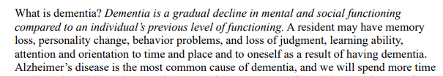

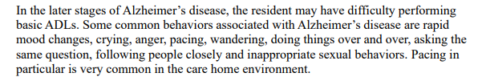
Dementia, Alzheimer’s
Bernard

Slide 35
Handling Care Clients who are unable to
Direct Self Care
Arul
LIFE SKILLS AND MAXIMISING FUNCTION IN CASES WHEN UNABLE TO DIRECTLY SELF-CARE
Individuals with dementia often have limited concentration. They may also be unable to direct self-care or plan activities on their own. They may also have trouble organising and carrying out independent activities, resulting in frustration, hopelessness and loss of self-esteem.
You can care for such persons by using activities that are matched to the person’s abilities. This can create a routine that can help them retain their positive self-esteem.
Take Stock by adapting or simplifying their past activities and hobbies to match the current functional, physical and cognitive abilities.
Build structure by creating a sense of order or routine
Routine makes the person more expectant, and there is a greater chance that he or she will look forward to the activity positively
Offer Support by focusing on offering guidance and supervision and doing things together.
You may have to show simple step-by-step directions to help do the activity, but the result can be a sense of accomplishment and satisfaction which can go a long way toward preventing depression and other illnesses.
Look for favourite activities to connect together.
Do not be too concerned that the person cannot make sense of the act. The real point is that it is familiar, and the person enjoys it.

Slide 36
Social, Recreational & Rehabilitative activities for Care Clients who are unable to Direct Self Care
Arul
Every person should have people to care for, as well as people who care about him or her.
Get clients involved in community groups and activities to build important social contact. Social contact is important to people, especially those who are unable to direct self-care, such as those with dementia or Alzheimer’s disease.
Encourage clients to interact with family members, friends and loved ones as this builds physical and mental health.
Some activities that can encourage clients to socialize include the following:
1. Introduction to new people
2. Introducing clients with shared interests.
3. Encouragement to participate in mutually enjoyable activities.
4. Communication with family and friends to find out more about interests and
hobbies.
5. Encouragement to join interest groups, activity groups or social committees connected to hobbies or special interests
6. Honouring personal rights to choose activities.

Slide 37
Fall prevention and general risk management principles
Arul
Helping someone to move keeps him or her active and improves muscle tone and leg strength. It also slows loss of bone mass and density related to osteoporosis.
The walker also gets a sense of accomplishment and greater independence.
Before moving out with the client, take note of these important points:
1. Allow the client to sit on a chair or the side of the bed before moving off to allow time for him or her to gain balance.
2. Make sure that you and the client both have sturdy shoes, footwear and clothing
3. Check for weakness in the legs or body. A person can sometimes get a hip fracture simply from walking due to osteoporosis, and then he falls.
4. Have adequate lighting at home or in the surroundings to prevent falls and manage risks.
5. Avoid clutter and look out for obstacles below eye level. Remove or store unnecessary furniture so as to have safe and smooth movement.
6. Ensure that the bathroom is safe by placing non-slip rubber mats in the tub and eliminating unnecessary debris.
6. Store hazardous chemicals or liquids safely and securely
7. Confusion, medications and distractions can affect a person’s ability to walk independently so be alert during each walk.
8. Use a gait belt, walker, or other ambulatory aid where necessary.
9. Stop to rest at the end of the journey or at a resting point along the way.

Slide 38
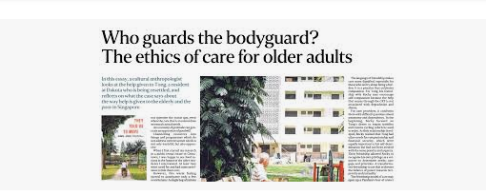
ETHICS – Case Studies for Discussion
Arul
Bernard

Slide 39
Additional slides for broader ecosystem, not for elder care giver training

Slide 40

Funding Framework
Horizon scan
Care Giver Workshops
Conversations with Clients
Process walkthrough; audits
Thematic reviews
VENDORS + PARTNERS
I
Care Giver Register
Risk Management Matrix
dentification
Care Clients and Care Giver matching algorithm
Knowledge Database
A
Likelihood
Impact
ssessment
Care Giver profile
HR + Finance work flows
Vendor: COUPA, Xero/Quicbook systems
R
Heat Map Actions
OSCA
Internal, external, consultants
esponse
Care Client Profile
Weekly Management Meetings
Action Item Tracker
Training,
Culture Workshop,
Int / Ext Comms
T
racking
To be further adapted
Care Giver
OnboardingOPs
Learning Management System
Collaboration tools : G-suite, Slack, Confluence, Wrike

Slide 41
Old slides
Division of labour
BC 11 slides
AJ 11 slides
Both ethics case studies

